Slide 1
Smart Energy Management

Slide 2
Summary of constraints/ requirements
Independent battery system
Wholesale market
Output : Schedule should be hourly-based for the current day (if before 2pm) or for today and the next day (if it is after 2pm).
Input: EPEX Spot, known fixed costs for grid per kWh, no costs of asset lifetime due to charge, battery of a known size (capacity, charge/discharge curve, efficiency)

Slide 3
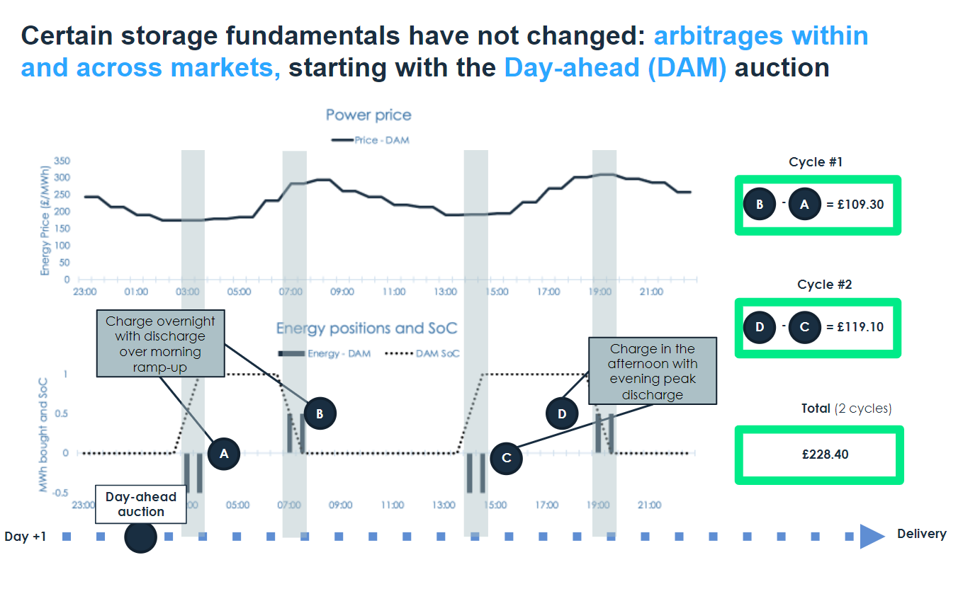
Battery storage market outlook: https://www.lcp.uk.com/our-viewpoint/2022/07/how-is-the-role-of-the-battery-storage-trader-changing/

Slide 4
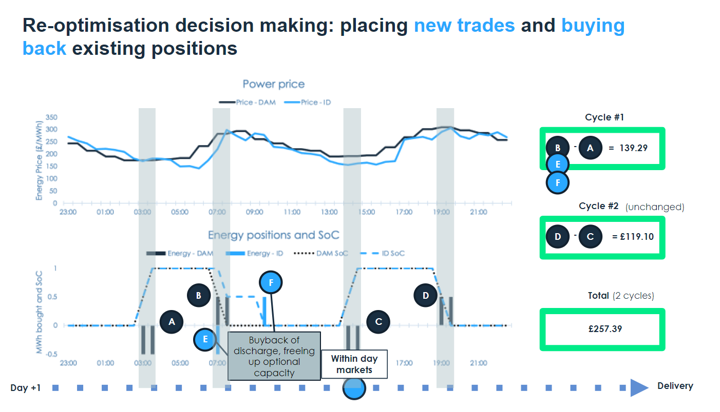

Slide 5
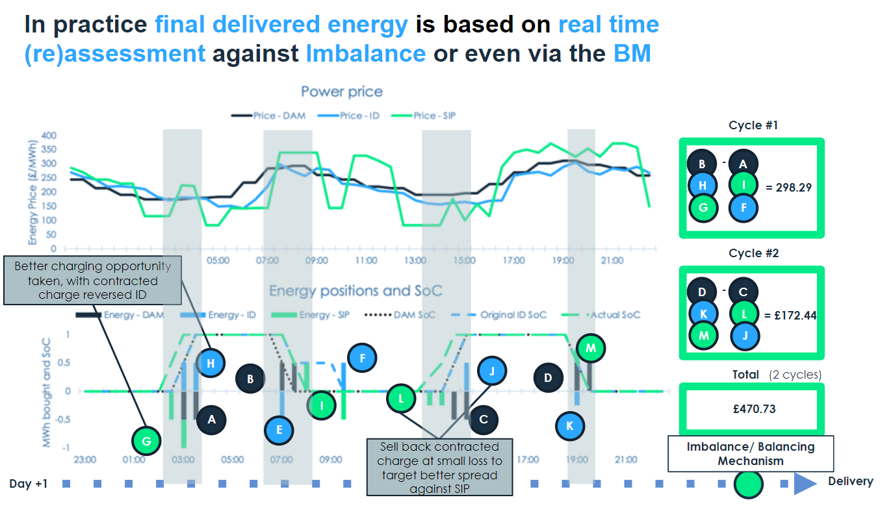

Slide 6
Related papers (independent battery systems)
  Energy Storage Arbitrage Under Day-Ahead and Real-Time Price Uncertainty, https://ieeexplore.ieee.org/ielaam/59/8231802/7892020-aam.pdf
Uses 24h ahead RT and DA price forecasting : “Both the DA and RT prices are forecasted for 24 hours upfront to comply with the decision procedure of energy storage owners that the bids are submitted for a whole day”
DAM optimization (2 methods) Quantity-Price and Quantity Only
RT market optimization (The accepted DAM bids are considered as input)
To make up for rejected DAM bids
To make additional profits based on the forecasted RTM prices.

Slide 7
Related papers (continued)
  Optimal Bidding, Scheduling, and Deployment of Battery Systems in California Day-Ahead Energy Market, https://ieeexplore.ieee.org/ielaam/59/7361773/7038219-aam.pdf
No forecasting
Economic and Self-Schedule bids to the day-ahead market and Self-Schedule bids to the real-time market.
Uses real data (no simulation, address battery lifetime, per-cycle profit valuation, and battery charge and discharge efficiency)
Solved using MILP solvers

Slide 8
Other papers (Storage + EV charging stations)
Development of Charging/Discharging Scheduling Algorithm for Economical and Energy‐Efficient Operation of Multi‐EV Charging Station https://arxiv.org/ftp/arxiv/papers/2205/2205.04116.pdf
Uses Deep learning
PV + EV station
Electric Vehicle Charging and Discharging Algorithm Based on Reinforcement Learning with Data-Driven Approach in Dynamic Pricing Scheme, https://www.proquest.com/docview/2391764007
→ Reinforcement learning + Price forecasting

Slide 9
Other papers (Storage + VRE)
Operation of concentrating solar power plants with storage in spot electricity markets, https://www.researchgate.net/publication/260633677_Operation_of_concentrating_solar_power_plants_with_storage_in_spot_electricity_markets
Optimal Operation of Independent Storage Systems in Energy and Reserve Markets With High Wind Penetration, https://www.researchgate.net/publication/260523395_Optimal_Operation_of_Independent_Storage_Systems_in_Energy_and_Reserve_Markets_With_High_Wind_Penetration

Slide 10
Next Steps
Develop a market + storage simulator on which strategy will be tested :
  Past European EPEX Spot price timeseries
  Grid fixed costs
  Battery specs

Slide 11
Next Steps (Continued)
Try first simple strategy :
Known number of charge/ discharge cycles per day
→Uninterrupted full charge discharge
Charge during hour with lowest average price
Discharge during hour with highest average price

Slide 12
Next steps defined after meeting :
Work on battery simulator (with charging/ discharging curve)
Work on market simulator (epex spot)

